Slide 1
Smart automation Robotic surgery-DaVinci
Students: Alican Andrei
Condrea Laurentiu
Chirion Bogdan
Grigore Valentin
Sile Marius
Specialization: Robotics
Year of study: IV

Slide 2
Smart Automation
The use of technology or automated systems to replace human activity in a process, with continuous monitoring and automatic adjustments, enables improved efficiency and optimization.
Key Features of Smart Automation:
Autonomy
Intelligence
Real-time response
Interconnectivity

Slide 3

Autonomy
Autonomy in smart automation refers to the ability of intelligent systems to make decisions and take action without human intervention, using sensors, algorithms, and artificial intelligence to adapt in real time to changes in the environment or process.

Slide 4
Intelligence
Intelligence in smart automation enables systems to understand and interpret complex data. This helps them make autonomous decisions, optimize processes, and adapt to changes in real time.

Slide 5
Real-time response
Real-time response refers to the ability of a system or process to respond to inputs or changes immediately or within a very short time frame, often in a manner that is perceived as instantaneous by the user. It ensures that data is processed and actions are taken without significant delays, typically in environments where timely responses are critical.

Slide 6
Interconnectivity
Interconnectivity refers to the state of being connected or linked together, allowing different systems, devices, or networks to communicate and exchange data. It enables the integration and interaction between various components, ensuring that they work together efficiently and can share information in real-time.

Slide 7
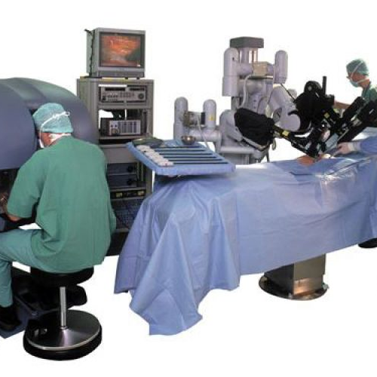
Autonomy in DaVinci
DaVinci is not autonomous (yet), a surgeon is always in control.
However, smart automation helps the surgeon a lot, think of it like autopilot in a plane, it assists, but the human is still in charge.

Slide 8
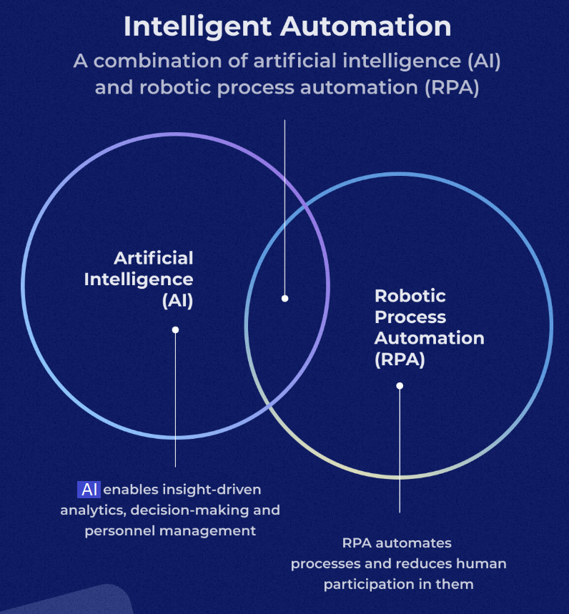
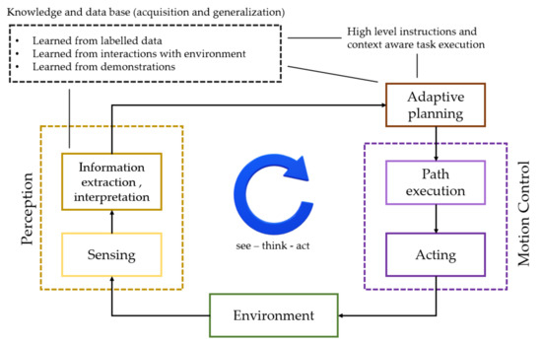
Artificial Intelligence in DaVinci
The artificial intelligence in the Da Vinci system helps analyze medical images, enhances visualization, monitors the robot's movements, and learns from surgeries to optimize performance.

Slide 9
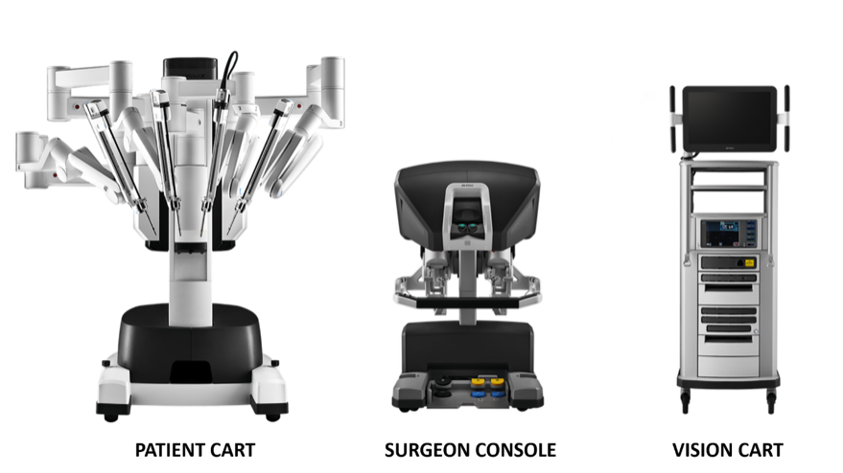
Interconnectivity
- Connectivity Between Robotic Components: The Da Vinci robot includes robotic arms that can be remotely controlled via a central console. These arms are equipped with specialized surgical instruments and a camera to provide a detailed view of the surgical area.
- Communication Systems: The Da Vinci robot uses internal communication networks to transmit data between different system components, such as robotic arms, control consoles, and visualization units(real-time monitoring). These networks allow for precise, real-time coordination of surgical instruments, ensuring a safe and accurate procedure.

Slide 10
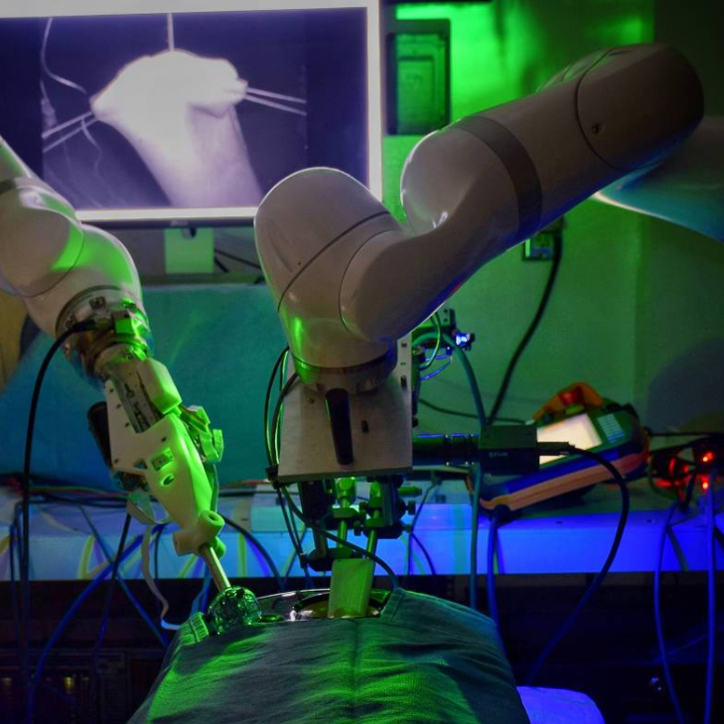
Robotics Assistance in DaVinci
The Da Vinci robot's arms are designed to assist the surgeon by providing precise, minimally invasive movements. The system automatically adjusts to the surgeon's hand movements and replicates them on a smaller, more accurate scale.
It filters out any unnecessary tremors or movements, which is particularly helpful in delicate surgeries.
The endowrist is used as an instrument for precision.

Slide 11
Da Vinci Surgical System: A Comparison of Patient Outcomes
Research Question: How do patient outcomes differ between surgeries performed with the Da Vinci system and those using traditional surgeries, specifically in terms of recovery time, complications, and hospital stay?
PICO :
Population: DaVinci Robot in surgery
Intervention: Smart automation in DaVinci surgical procedures
Comparison: Traditional surgeries
Outcome: Recovery time, complication rates, and length of hospital stay

Slide 12
Da Vinci Surgical System: A Comparison of Patient Outcomes
For the search equation, the keywords were "da vinci" or "davinci" and "automation" with the specification "Abstract." As a result of the search, 40 articles were found, which were then filtered using Exclusion criteria. We used IEEE as database.
The filtering criteria applied were the following:
Duplicate records.
Unable to retrieve the full article.
Language other than English.
Topic not relevant to the research question.
System specifications not listed.

Slide 13
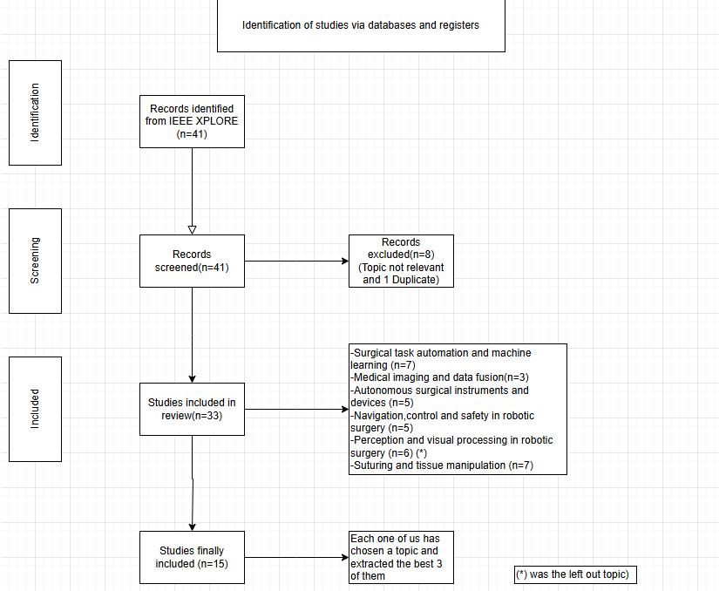
PRISMA diagram

Slide 14
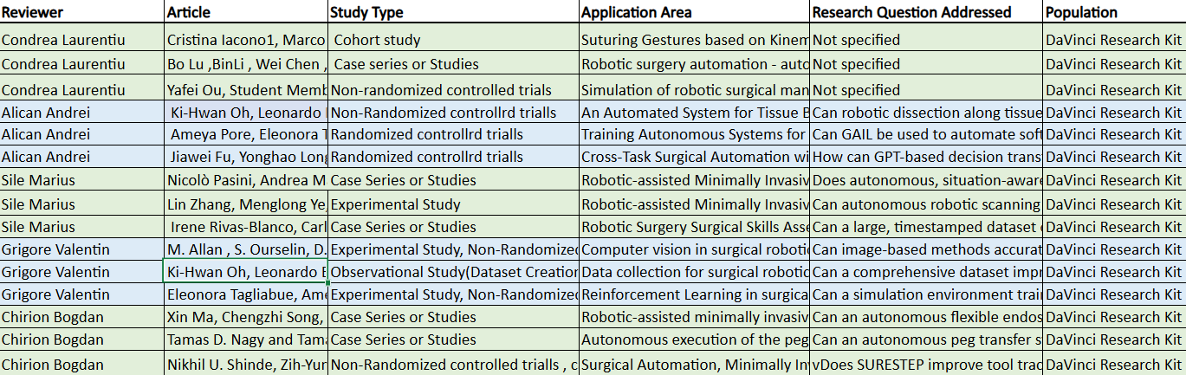
Data extraction - Excel

Slide 15
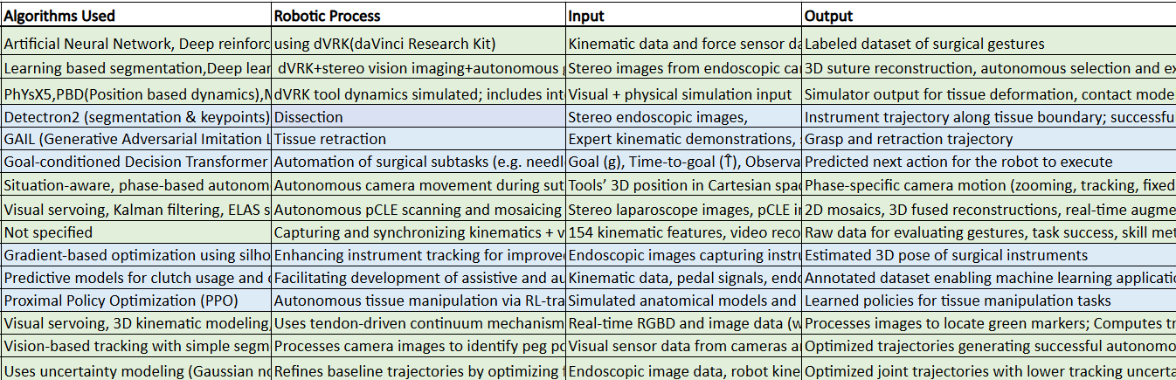
Data Extraction - Excel

Slide 16
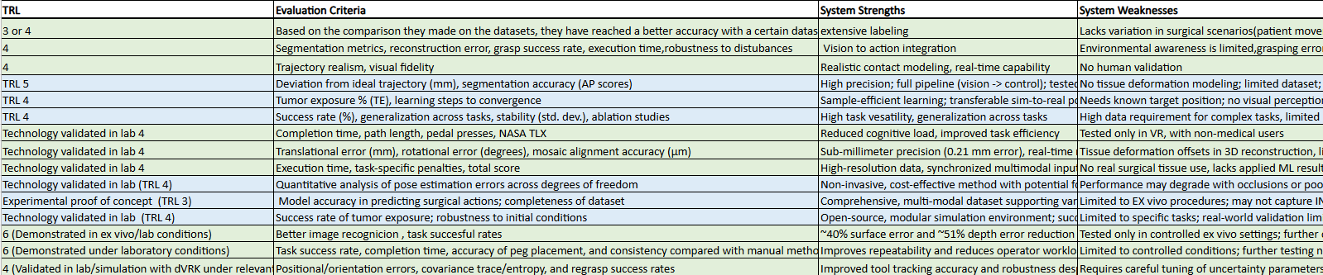
Data Extraction - Excel

Slide 17
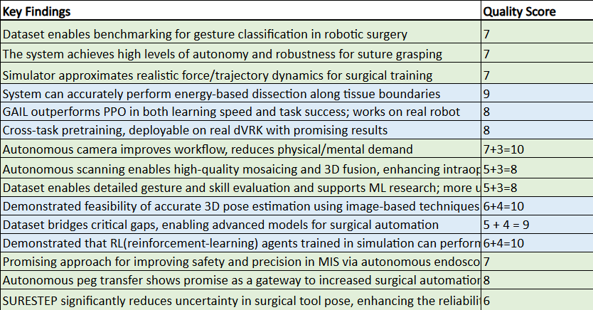
Data Extraction – Excel

Slide 18
Basic conclusion
In conclusion, based on our analysis of the reviewed articles, we can state that the precision and autonomy of the Da Vinci surgical robot can be significantly enhanced through the use of the Da Vinci Research Kit, allowing the reduction of various disturbance factors that may affect surgical performance. Furthermore, when comparing traditional surgery to Da Vinci-assisted procedures, we observe that robotic surgery generally leads to shorter recovery times, reduced hospital stays, and fewer postoperative complications. These advantages result mainly from the minimally invasive techniques enabled by robotic assistance, such as smaller incisions, reduced blood loss, and lower infection risks, which together contribute to better patient outcomes and a faster return to daily activities.

